Slide 1
Connecting RESTful Web Service to JPA

Slide 2
Objectives
Why connect a RESTful web service to JPA?
Java Persistence API
Spring Data JPA
The Implementation Spring REST with JPA

Slide 3
Why connect a RESTful web service to JPA?
Connecting RESTful web services to JPA offers several key advantages for building modern, data-driven applications
Simplified data access - JPA provides an object-oriented way to interact with relational databases, abstracting away the complexities of SQL and JDBC.
Enhanced performance - JPA can optimize database queries and caching strategies, leading to improved application performance.
Clear separation of concerns - RESTful web services handle the presentation and communication aspects of the application, while JPA manages the persistence layer.

Slide 4
Java Persistence API
Standard for object-relational mapping (ORM) in Java
Simplifies database interaction
Object-centric view of data

Slide 5
Spring Data JPA
Simplified repository implementation
Custom query methods. Spring Data JPA automatically derives the corresponding JPQL queries based on the method names.
Spring Data JPA eliminates the need for writing boilerplate code for common data access tasks. T
Improved code maintainability:
Integration with Spring Framework - dependency injection and transaction management.
Support for various relational databases

Slide 6
The Implementation Spring REST with JPA
Project setup
Create the domain model
Create the Data Access Layer
Create the Service Layer
Create the REST Controller
Additional considerations

Slide 7
Project setup - 1
Spring Boot 3+ with dependencies
Spring Boot Web Starter
Spring Data JPA
Database Driver (MS SQLServer)
JDK 21+
Maven 3.2+
IDE IntelliJ IDEA
RDBMS Microsoft SQL Server

Slide 8
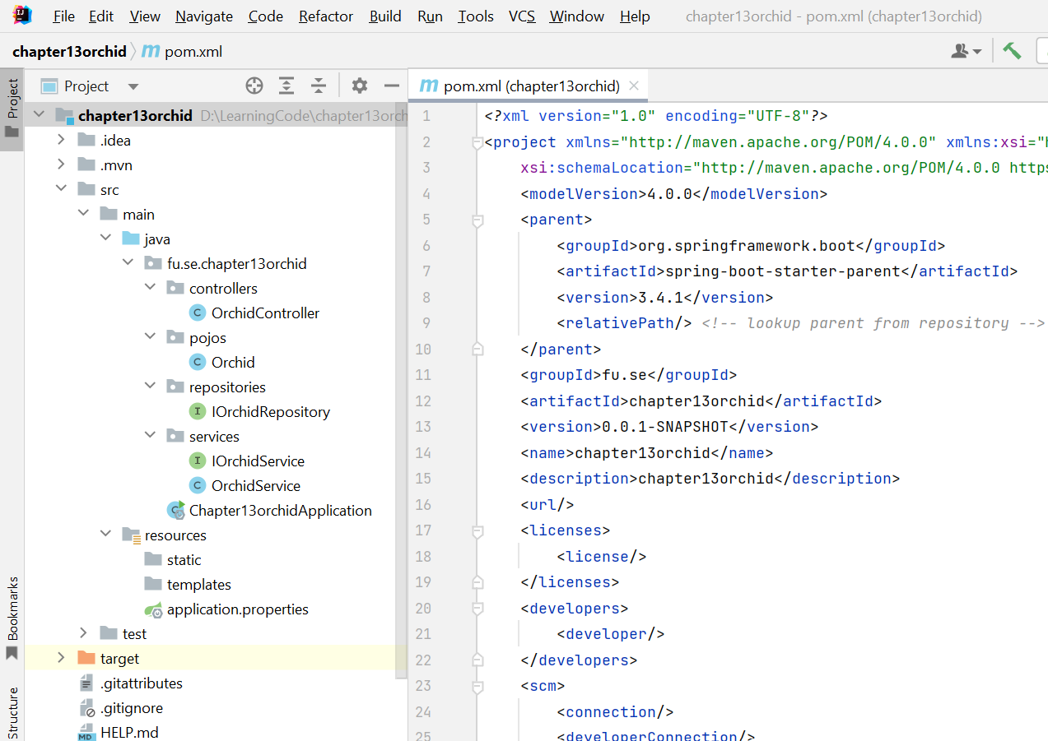
Project setup - 2
Project structure

Slide 9
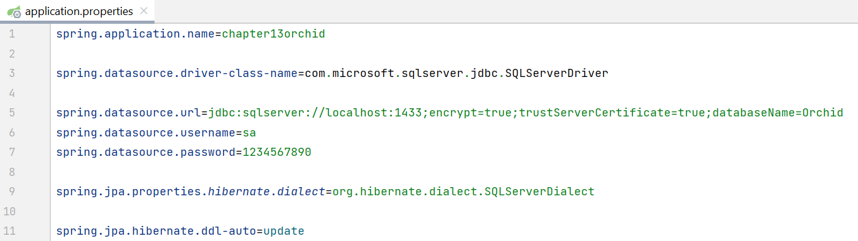
Project setup - 3
Add information for application.properties
Driver
Url
Others

Slide 10
Create the domain model - 1
Entity Class: Represents a database table
Annotations:
@Entity: Marks the class as a JPA entity
@Id: Specifies the primary key field
@GeneratedValue: Strategy for generating primary key values
@Column: Maps a field to a database column

Slide 11
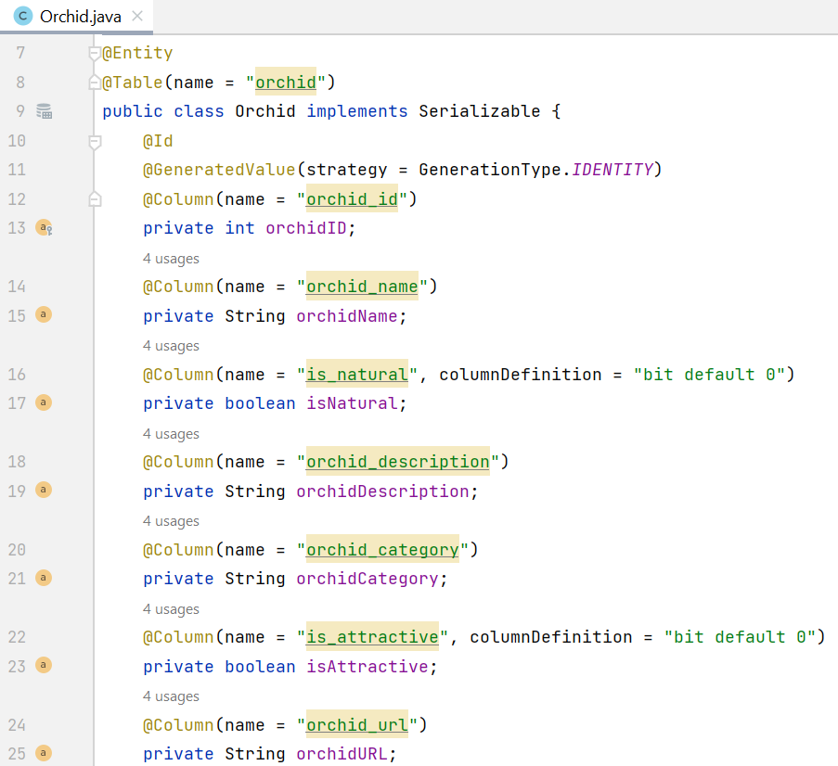
Create the domain model - 2

Slide 12
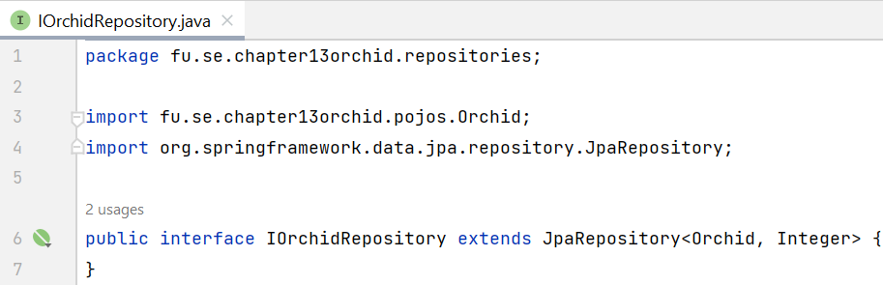
Create the Data Access Layer
Create JPA repository interface, this interface extending JpaRepository
Provides CRUD operations and more
No implementation needed (Spring Data JPA provides it)

Slide 13
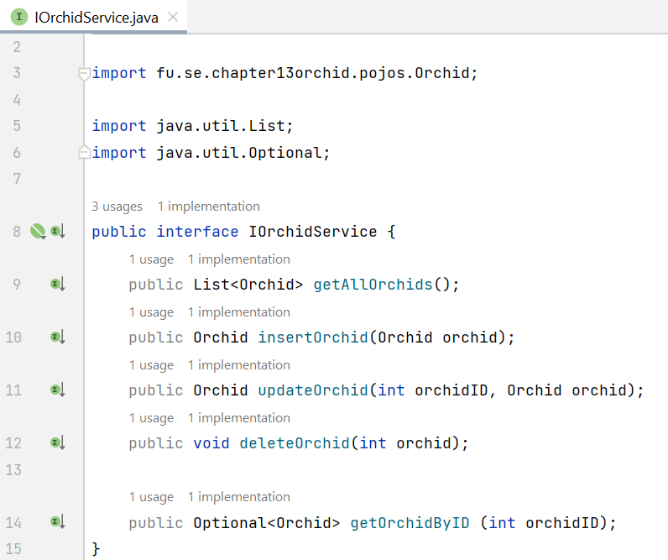
Create the Service Layer - 1
Define Service Interfaces: Create interfaces to define the business logic for application.
Implement Service Classes: Implement the service interfaces and use the repositories to interact with the database.

Slide 14
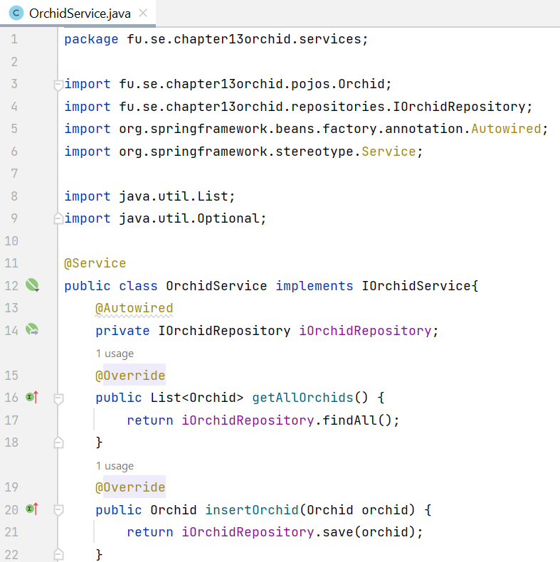
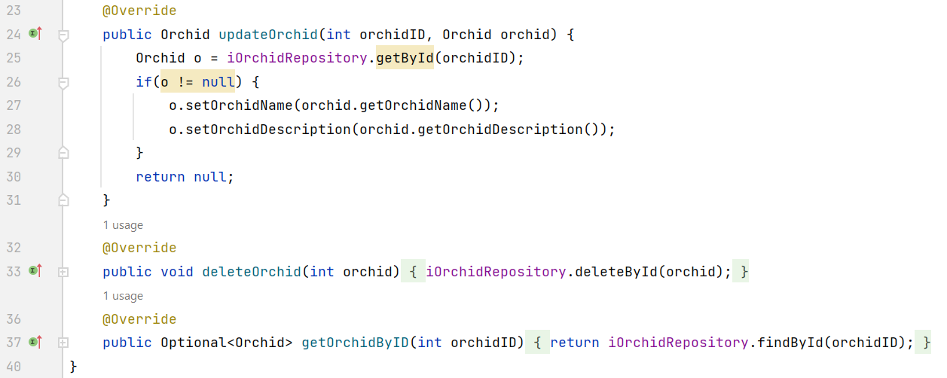
Create the Service Layer - 2

Slide 15
Creating a REST Controller - 1
Define controller classes: Create classes annotated with @RestController to handle HTTP requests.
Map endpoints: Use annotations like @GetMapping, @PostMapping, @PutMapping, and @DeleteMapping to map HTTP methods and paths to controller methods.
Handle requests: Implement controller methods to process requests, interact with the service layer, and return responses.

Slide 16

Creating a REST Controller - 2
Dependency Injection
@Autowired Injects dependencies into classes
Spring manages the lifecycle of beans
Implementing CRUD Operations
GET: Retrieve item(s) (@GetMapping)
POST: Create a new item (@PostMapping)
PUT: Update an existing item (@PutMapping)
DELETE: Delete an item (@DeleteMapping)

Slide 17
Creating a REST Controller - 3
@RequestMapping - Maps HTTP requests to specific controller methods based on the request path, HTTP method, and other criteria. It can be used at both the class and method level. Attributes of @RequestMapping:
value: Specifies the request path.
method: Specifies the HTTP method (e.g., RequestMethod.GET, RequestMethod.POST).
params: Specifies request parameters that must be present.
headers: Specifies request headers that must be present.
consumes: Specifies the content type of the request body.
produces: Specifies the content type of the response body.

Slide 18
Creating a REST Controller - 4
The annotations are shortcuts for @RequestMapping with specific HTTP methods. They simplify the code and improve readability.
@GetMapping
@PostMapping
@PutMapping
@DeleteMapping
@PatchMapping
@PathVariable: Extracts values from URI path variables and binds them to method parameters.

Slide 19
Creating a REST Controller - 5
@RequestParam - Extracts values from query parameters and binds them to method parameters.
@RequestParam attributes:
value: Specifies the name of the query parameter.
required: Indicates whether the parameter is required.
defaultValue: Specifies a default value if the parameter is not present.

Slide 20
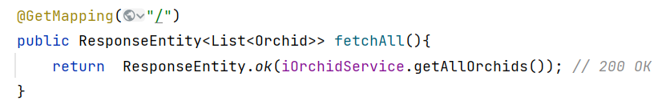
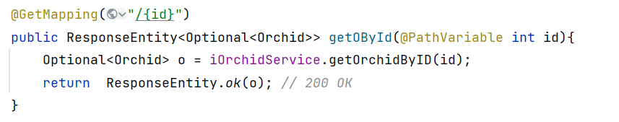
Creating a REST Controller - 6
GET Request Handling @GetMapping, @GetMapping({id})
Retrieves data from the database
Can handle path variables and request parameters

Slide 21
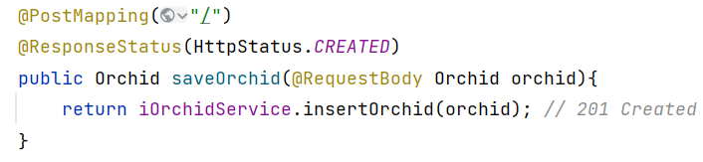
Creating a REST Controller - 7
POST Request Handling @PostMapping
Creates a new product in the database
Receives data in the request body

Slide 22
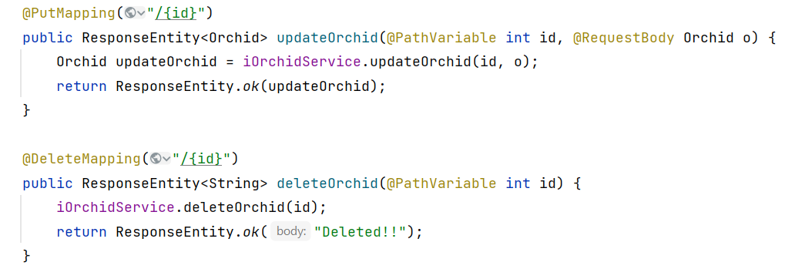
Creating a REST Controller - 8
PUT Request Handling @PutMapping("/{id}“)
Updates an existing product
Receives data in the request body

Slide 23
Creating a REST Controller - 9
DELETE Request Handling @DeleteMapping("/{id}“)
Deletes a product from the database

Slide 24
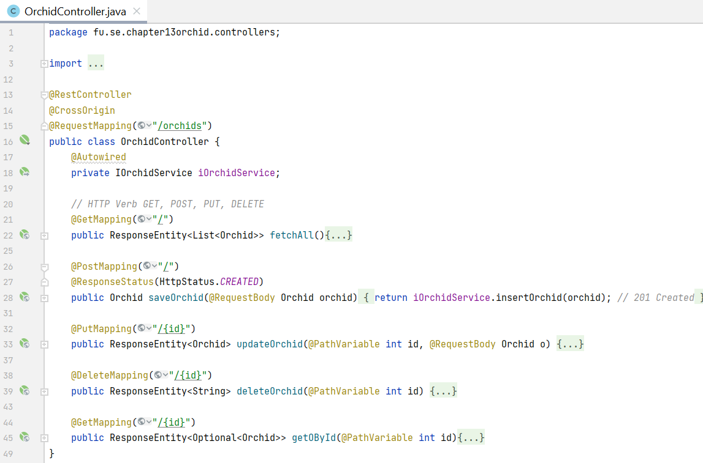
Creating a REST Controller - 10

Slide 25
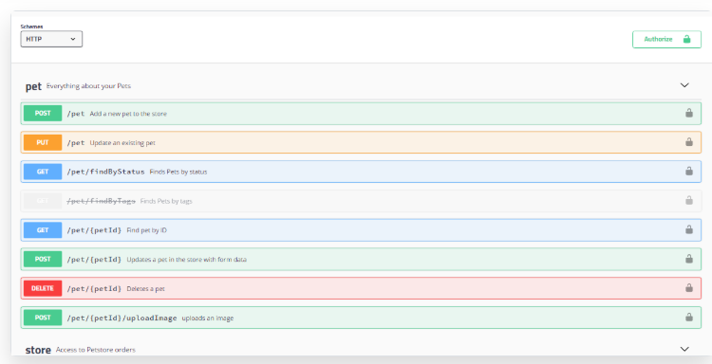
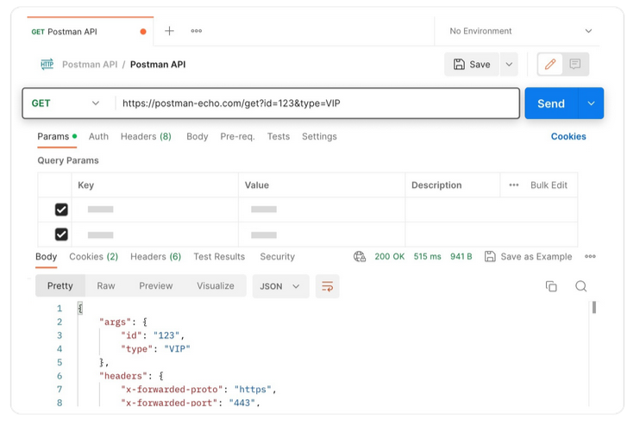
Accessing REST Applications - 1
Browser extension
Postman (Chrome browser extension)
RESTClient (Firefox extension)
Graphical User Interfaces (GUIs)
Postman
Swagger UI
Insomnia

Slide 26
Accessing REST Applications - 2
 |  | HTTP Method | Path | Status Code
1 | GET Orchids | GET | http://localhost:8080/orchids | 200 OK
2 | POST Orchid | POST | http://localhost:8080/orchids | 201 Created
3 | DELETE Orchid | DELETE | http://localhost:8080/orchids/{id} | 204 No Content
4 | PUT Orchid | PUT | http://localhost:8080/orchids/{id} | 200 OK
5 | GET Orchid | GET | http://localhost:8080/orchids/{id} | 20 OK

Slide 27
Additional considerations
Error Handling: Implement proper error handling to provide informative error responses.
Security: Secure API using Spring Security.
Documentation: Generate API documentation using Swagger.
Testing: Write unit and integration tests to ensure the functionality of this API.

Slide 28
Summary
Concepts were introduced:
Why connect a RESTful web service to JPA?
Java Persistence API
Spring Data JPA
The Implementation Spring REST with JPA

